Slide 1



Ed Foster
Head of Student Engagement & Analytics
Nottingham Trent University

Slide 2


Where am I going to explore?
My framework
  Engagement, retention & learning analytics for ‘success’
  Role of technology
Setting up learning analytics
  Why, ethics & change management
  NTU as an example
Three recent Erasmus+ projects
  Key lessons
Some attempt to bring it all together

Slide 3

Student Engagement & Learning Analytics

Slide 4



Student Engagement
College impact model
(see Tinto 1993 & Astin 1993)
Student background
Socio-economic background, expectations of university and personal goals
Student Engagement
Time on task, motivation, knowing how to learn,
learning from others, managing own time, learning from feedback, seeking help where needed, healthy control of own stress and emotions, balancing study, social, family & other external commitments
Student Outcome
pass, fail, repeat, personal growth & change, employment & life opportunities
+
x
=
Prior educational experience
Experience of success/ failure
Learning the rules
University Environment
Transition support, supportive and inspiring teaching, sociability of the course, opportunities to pursue personal interests & participate in clubs & societies etc., clarity of expectations, quality of feedback,
course that meets student expectations,
provision of further support
Socio-economic context

Slide 5

How do we build student capacity/ reduce early departure?
Preventative (design problems out)
  Curriculum design
  Induction, scaffolding assessment
  Mentors/ buddies
  Better feedback mechanisms, reflective writing
  Belonging
  Technology-enhanced personalisation
Remedial (respond to problems)
  Use of early warnings
    Non-submission of coursework
    Non-attendance

Slide 6

Learning Analytics
for
Student Success
“Learning Analytics is about collecting traces that learners leave behind and using those traces to improve learning” (Duval, E., 2012)
  “Learning and environments” (Siemens, G., 2011)
  “Actionable insights” (Cooper, A., 2012)
  Learning analytics for success “early identification of students predicted to be at risk of failure or withdrawal” (Sclater, 2017, pg. 35)
Field growing from mid 2000s in US
Big data revolution
Results not proven

Slide 7






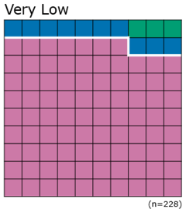
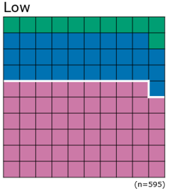
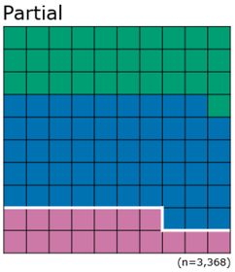
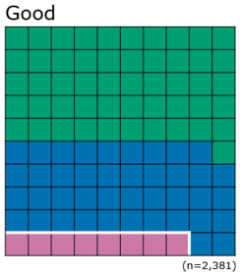
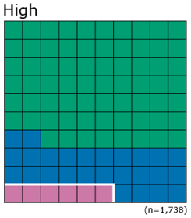
Relationship between engagement & success (2017-18)
Key:
Did not progress
Progressed with a grade equivalent to a 2:2 or lower
Progressed with a grade equivalent to a 2:1 or 1st

Slide 8

Implementing Learning Analytics
The NTU Student Dashboard

Slide 9
Implementing Learning Analytics
Improve student success
Improve success for most disadvantaged students
The NTU Student Dashboard
Developed by commercial partner Solutionpath
2012/13 pilot – 2 academic schools
Full implementation group (2014 – 2018)
Management group (2018 onwards)
Student consultation at every stage
Staff representation from across the institution

Slide 10

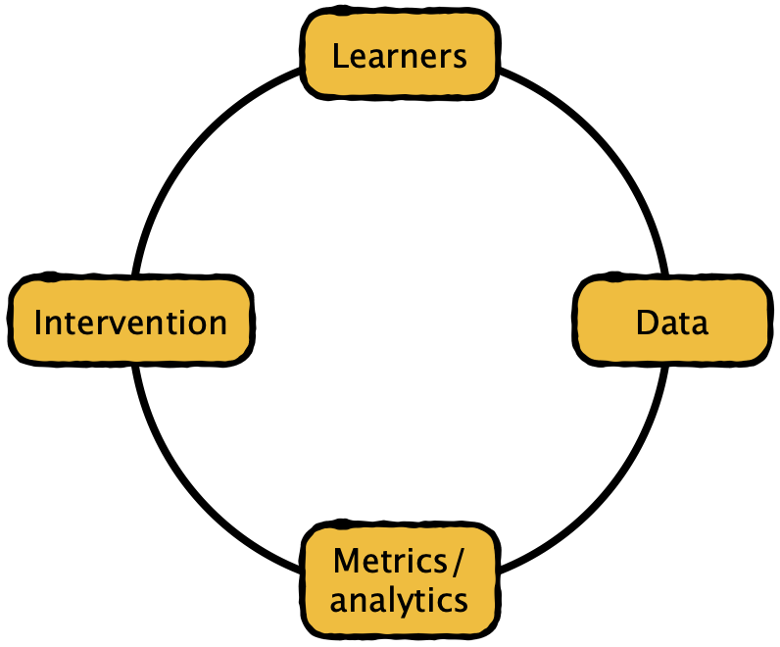
Learning Analytics Cycle,
(Clow 2012)

Slide 11
NTU Student Dashboard
Data
Algorithm data sources
VLE (LMS) log ins
VLE Learning Room log ins
Attendance
Electronic resources
Online submission
Not used but shown in Dashboard
Card swipes
Library loans
Asked to be added
MS Teams
Contextual information
Entry qualifications
Don’t use background data
Intervention
1 Data in Dashboard
Students can see own data
Use in tutorial conversations
2 No-engagement alerts
3. Organised campaigns
4. Log interventions
Record
Metrics
Algorithm calculates engagement overnight
Generates no-engagement alerts

Slide 12
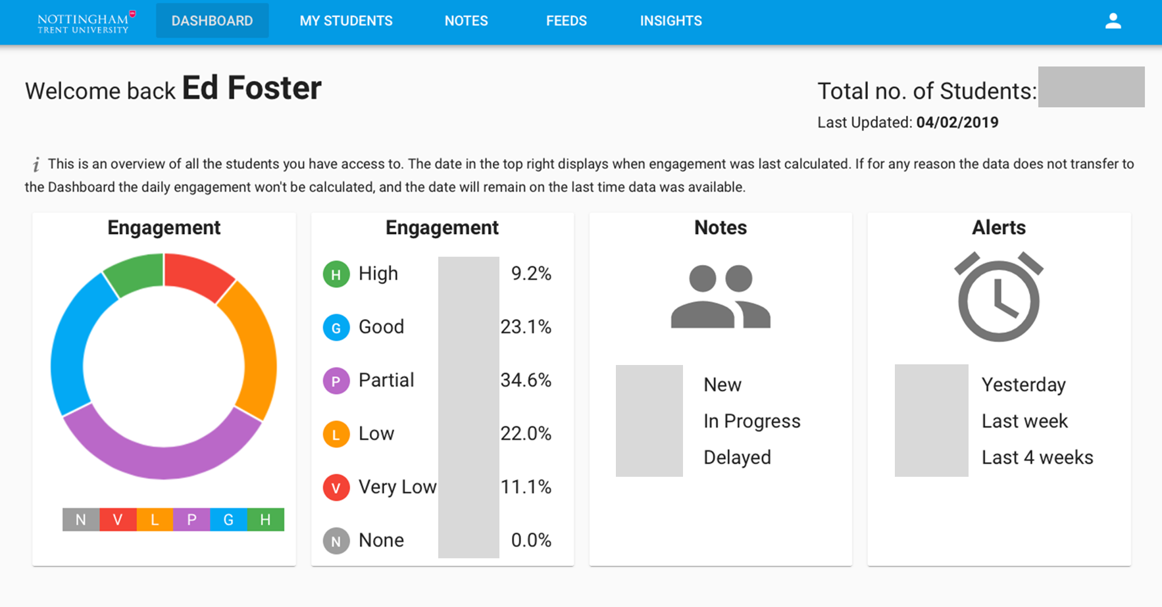

Slide 13
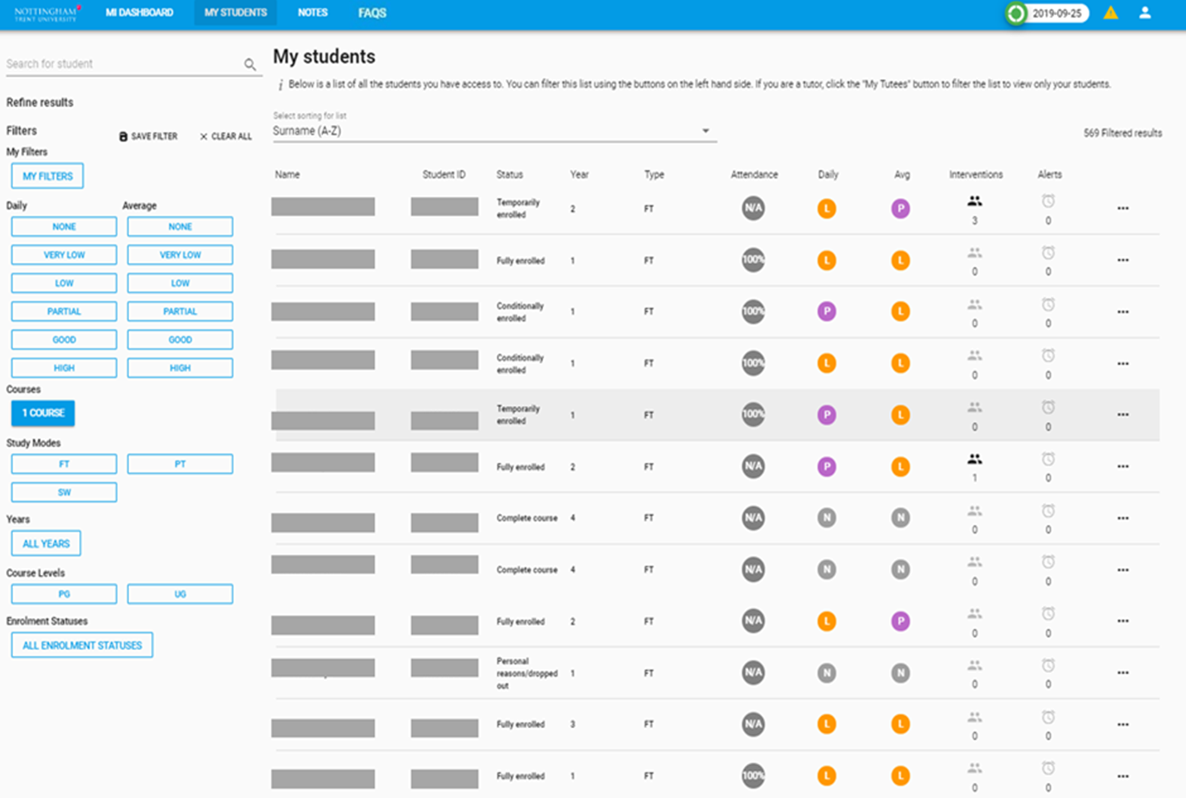

Slide 14
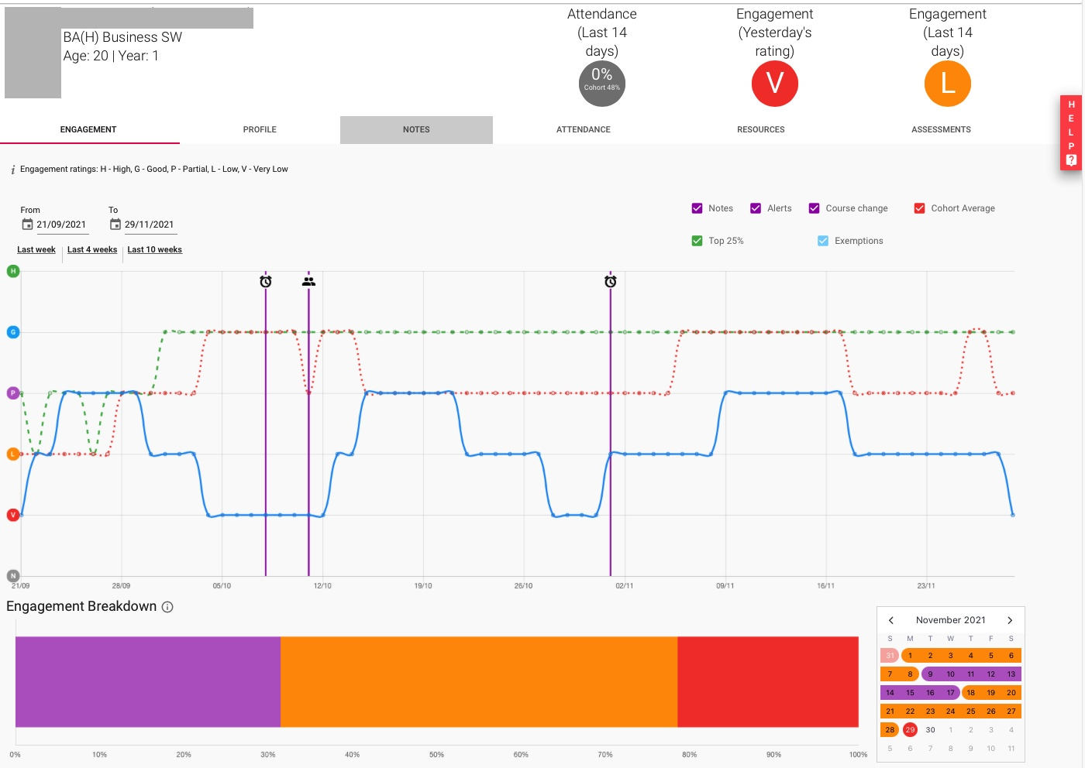
Student info
Time period =
since start
of term
Top 25%
Cohort
average
Notes added
Individual
student
Automatic alerts
Engagement
bar chart
Engagement
Calendar view

Slide 15

Ethics

Slide 16

Ethics
Privacy/ legal
Purpose & consequences
Not using is an ethical stance
Sharing data with students
Better outcomes/ more work?
Creeping wedge
Policy & development

Slide 17

Findings from Erasmus+ Projects
ABLE & STELA
OfLA

Slide 18
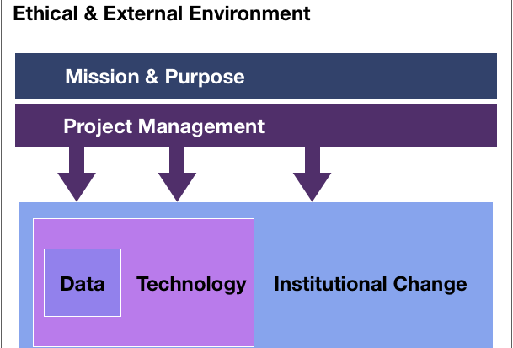
ABLE Project
https://www.ableproject.net

Slide 19
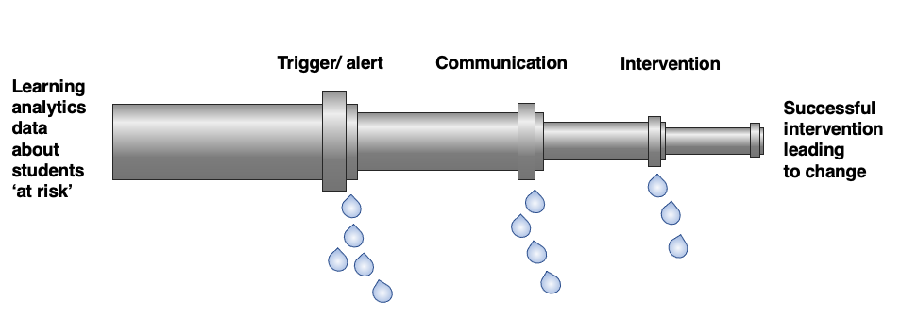


The OfLA Project
https://oflaproject.eu

Slide 20
Start with the end in mind
Design from the perspective of the planned intervention
In our setting, a face-to-face conversation
  What processes need to happen for that conversation to take place?
    Data, Policy, Systems, Staff development, Estates, resourcing
  Work backwards through the barriers to overcome
    What can you work around?

Slide 21

Trigger/ alert
Valuable as a definite point
  Unambiguous
Different types possible
  Self-reflection/ self-referral
  Binary (non-submission/ academic failure)
  Threshold (e.g. engagement rating, % attendance)
Autonomy versus ease of use
  Each decision point adds time and complexity, but adds ownership
  Data literacy
Institutional capacity to act

Slide 22

Communication
(Most) students appreciated communication
No perfect system, all we can hope for is to mitigate the flaws in each media
Student views remain nuanced about communication
  Overall, want emails to ’official’ email channels
  Texts as a preparation for calls
  Personal social media still private
Communication is part of the process, not the end step
  Although may be sufficient for students with capacity to change
Communication is a record
  Useful for other colleagues supporting students & as a record
“Despite everything happening in the world, I wasn’t forgotten about or abandoned by Uni.”

Slide 23

Intervention
Believe that an intervention is essential
  Not all students possess the skills/ confidence to change
Use of systems to de-personalise the intervention/ take the heat out of the contact
Data as a means to identify the change needed
Coaching approach need to act ‘softly’
  Don’t overload the student
  First steps – act
Personalisation
  CRM type approach, network & web of support
The call …
“Motivated me to start getting back into my studies”

Slide 24
Data about ’rang, but couldn’t leave a message’ and ‘rang, but left a voicemail’ excluded for clarity: results were between those shown above

Slide 25

What needs to happen for change to take place?
Student needs to:
  Know how they need to be different
  Believe that they can be different
  Possess skills to change
  Have capacity to change
Humans are hard-wired to
  Ignore evidence/ downplay it
  Misinterpret/ selectively understand evidence
Learning analytics is a psychological/ pedagogical project, not a tech project

Slide 26


Challenges
Evaluation
Thank you for listening
https://livinglearninganalytics.blog
@edfoster
Challenges
During the first four weeks of the summer term
  Team of 30 volunteers
    5,700 phone calls
    Spoke to 2,300 students
    780 referrals to Student Support Services or Personal tutors
“Despite everything happening in the world, I wasn’t forgotten about or abandoned by Uni.”
“It was really helpful to know that there was a safety net supporting you to help students engage and who are not responding to you. It also made you feel like it wasn’t all down to you and took off some pressure.”
Challenges

Slide 27
References
Astin, A., What Matters in College: Four Critical Years Revisited. (1993). San Francisco, Jossey-Bass
Clow, D., 2012, The Learning Analytics Cycle, https://dougclow.org/2011/02/28/the-learning-analytics-cycle/
Cooper, A., 2012, What is Analytics? Definition and Essential Characteristics, Vol. 1, No. 5. CETIS Analytics Series, http://publications.cetis.ac.uk/2012/521
Duvall, E., 2011, Learning Analytics and Educational Data Mining, https://erikduval.wordpress.com/2012/01/30/learning-analytics-and-educational-data-mining/
Sclater, N., 2017, Learning Analytics Explained, UK, Routledge
Siemens, G., 2011, Learning and Academic Analytics http://www.learninganalytics.net/?p=131
Tinto, V. (1993). Leaving College: Rethinking the Causes and Cures of Student Attrition (2nd ed.). Chicago: University of Chicago Press
Further Resources
https://www.solaresearch.org
https://www.jisc.ac.uk/learning-analytics
https://www.solutionpath.co.uk

